Slide 1
DevOps
Notes:
https://courses.cs.washington.edu/courses/cse403/13au/lectures/git.ppt.pdf
http://enos.itcollege.ee/~jpoial/allalaadimised/git/getting-started-with-git.pdf

Slide 2
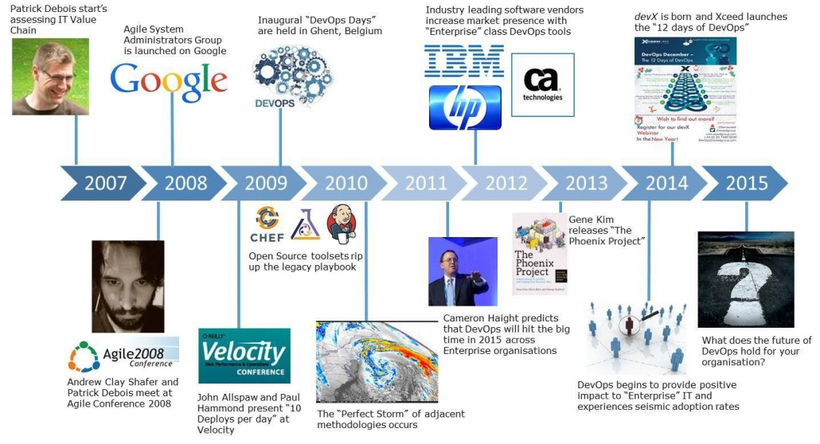
History

Slide 3
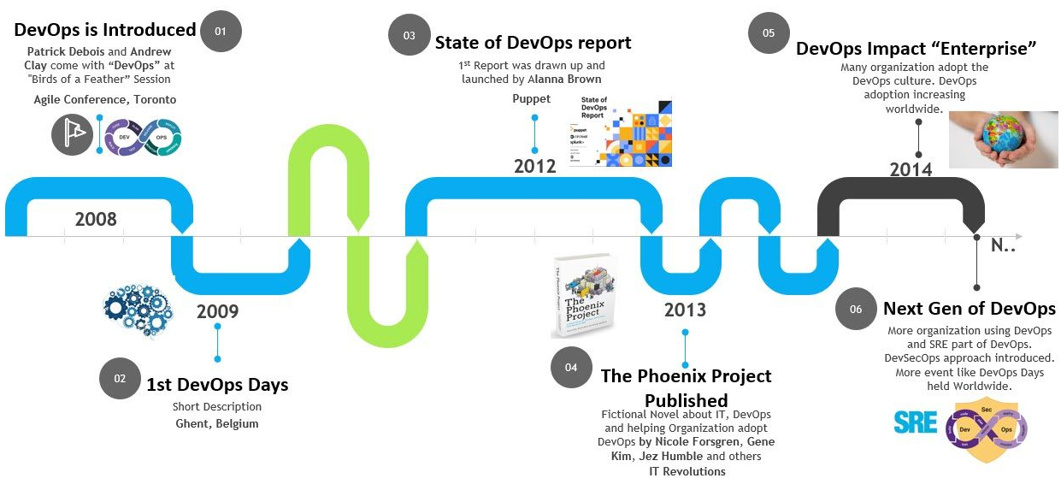
History

Slide 4
Configuration management
Process of maintaining systems, such as computer hardware and software, in a desired state
Configuration Management (CM) is also a method of ensuring that systems perform in a manner consistent with expectations over time.

Slide 5
Benefits of Configuration Management
Reduces risk of unpredictable system failures
because it offers perfect visibility and tracks every change made to test environments.
Reduces costs
Offers greater agility and better resolution of issues
Implement faster restoration of services

Slide 6
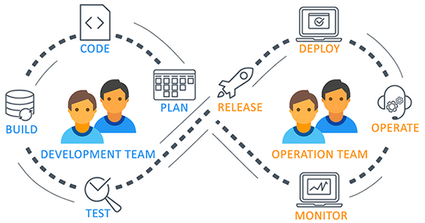
What and why of DevOps?

Slide 7
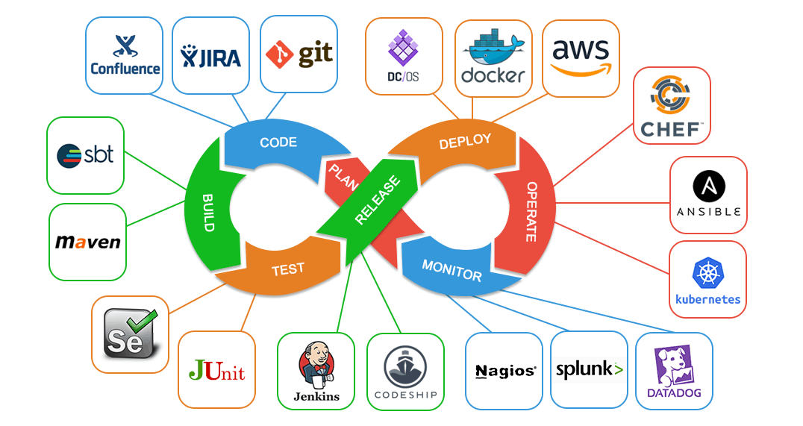
What and why of DevOps?

Slide 8
What and why of DevOps?

Slide 9
What and why of DevOps?

Slide 10
What and why of DevOps?

Slide 11
Early Defects vs Delayed Defects detection

Slide 12

DevOps as a solution and Advantages

Slide 13
DevOps as a solution and Advantages
Speed
Rapid Delivery
Reliability
Scale
Improved Collaboration
Security

Slide 14
DevOps Tools – Overview and Use case

Slide 15
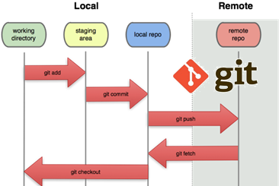
Source control
To ensures for working on the right version
Important for maintaining a single source of truth

Slide 16
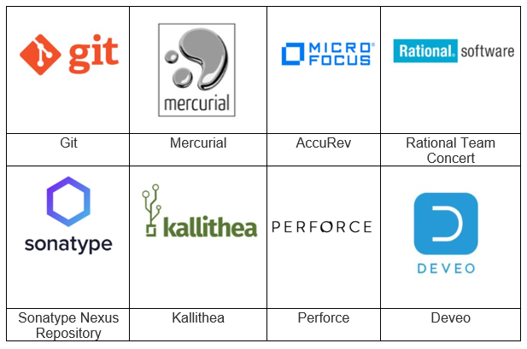
Source Code Management (SCM Tools)
Help to keep track of code
Complete history of changes.

Slide 17
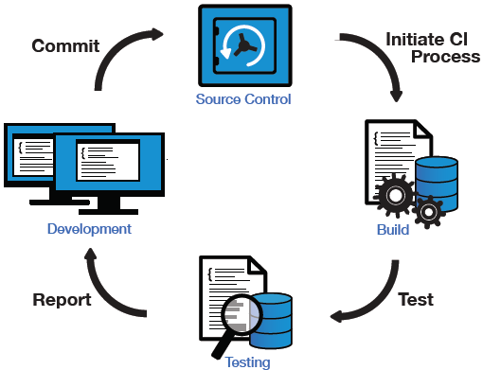
Continuous Integration
Push

Slide 18
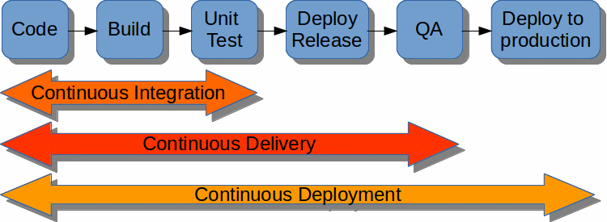
Continuous Delivery and Deployment

Slide 19
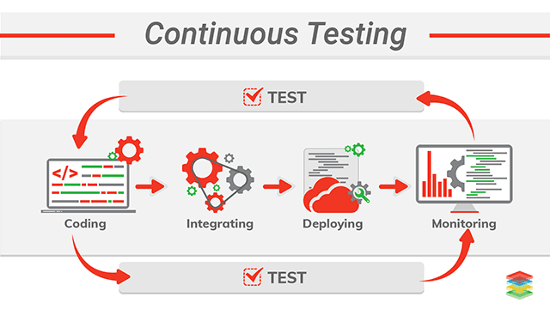
Continuous Testing

Slide 20
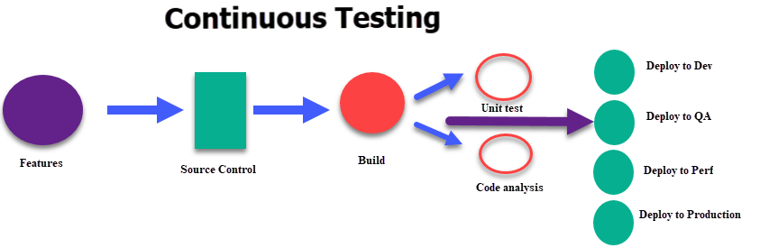
Continuous Testing

Slide 21
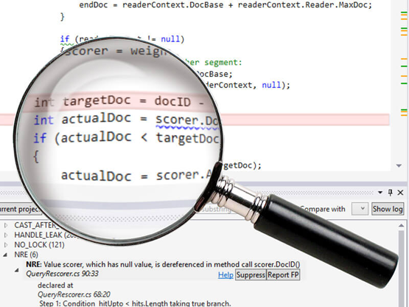
What Is Static Code Analysis?
A method of debugging
Examine source code before a program is run
Done by analyzing a set of code against a set of coding rules.
Performed early in development

Slide 22
Static Code Analysis Tool
Development teams are under pressure
Quality releases needed to be delivered on time
Coding and compliance standards need to be met
And mistakes are not an option.
That’s why development teams are using static analysis tools.

Slide 23
Static Analysis vs. Dynamic Analysis
Static analysis
Identifies defects before running a program (e.g., between coding and unit testing).
Dynamic analysis
Identifies defects after running a program (e.g., during unit testing)

Slide 24
Few Static Code Analysis Tools
Apache Yetus
Code Dx
ConQAT
Coverity
IBM Security AppScan
Facebook Infer
Lint
SonarQube
SourceMeter
For complete list refer:
https://en.wikipedia.org/wiki/List_of_tools_for_static_code_analysis

Slide 25
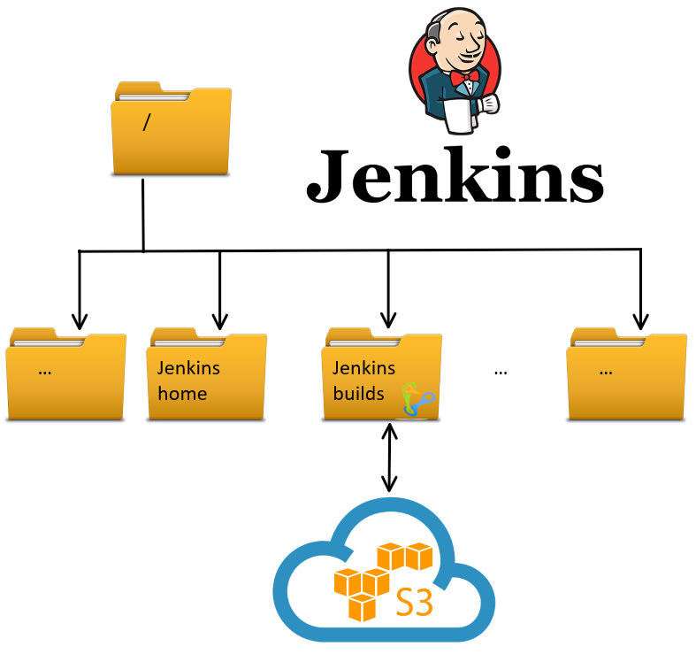
Storage Artifacts

Slide 26
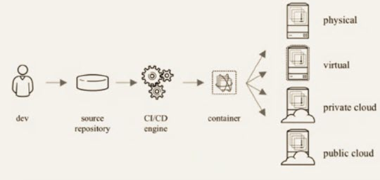
Containerization
Notes:
Containers are a solution to the problem of how to get software to run reliably when moved from one computing environment to another
This could be
From a developer's laptop to a test environment
From a staging environment into production and
From a physical machine in a data center to a virtual machine in a private or public cloud.
A container consists of an entire runtime environment:
An application, plus
All its dependencies, libraries and other binaries, and configuration files needed to run it, bundled into one package

Slide 27
Configuration Management
A process for maintaining
Computer systems
Servers, and
Software in a desired, consistent state
Notes:
Why manage configurations?
Keeps you from making small or large changes that go undocumented
These misconfigurations can lead to poor performance, inconsistencies, or noncompliance and negatively impact business operations and security.
When undocumented changes are made across many systems and applications, it adds to instability and downtime.

Slide 28
Benefits of Configuration Management for Servers
Quick Provisioning of New Servers
Quick Recovery from Critical Events
Version Control for the Server Environment
Replicated Environments

Slide 29
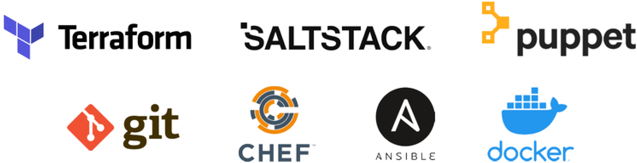
Configuration Management Tools

Slide 30
Thanks

